Slide 1



Team #2
Solar Car Project
Senior Design 2010 - 2011

Slide 2
Meet The Team
Electrical Engineers (EE)
  Project Manager – Zachary Prisland
  Battery Specialist and Treasurer – Shishir Rajbhandari
  Power Technical Lead – James Barge
Mechanical Engineers (ME)
  Mechanical Lead and Team Organizer – Keith Dalick
  Test Engineer – Adrian Cires
  King of Suspense(ion) – Emiliano Pantner

Slide 3
Meet The Team
Industrial Engineers (IE)
  Industrial Lead – Nelson German
  Quality Technician – Rajat Pradhan
  Lead Manufacturer and Secretary – Amanda Roberts
Graduate Advisor – Chris Widener

Slide 4
American Solar Challenge
Fundamental Vision
  The American Solar Challenge (ASC), hosted by the Innovators Education Foundation, seeks to promote and celebrate educational excellence and engineering creativity. Fueled by the spirit of friendly competition and teamwork, the ASC champions the creative integration of technical and scientific expertise across a range of exciting disciplines.

Slide 5
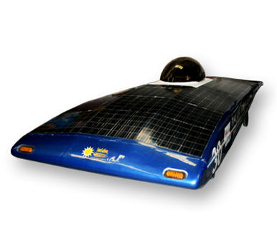
Old Design
Fiberglass Exterior
Steel Frame
Four wheel design
  Motor on one of the rear
  Brakes on other three
Lead-Acid Batteries

Slide 6
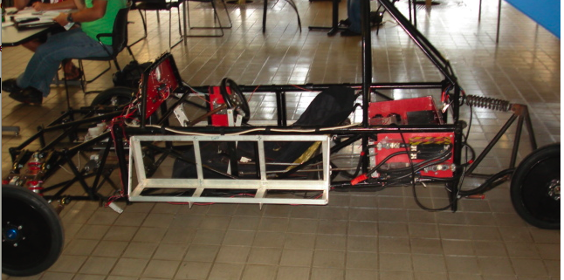
Progress in Phase 1
Revamped electrical system
  New Batteries
  Charging System
  Reworked Dashboard
Stripped off Fiberglass
Worked on suspension
Removed one tire

Slide 7
Capabilities
Required
Desired
Moving vehicle powered with stored energy in batteries
Ability to carry a driver and provide control over the vehicle
Solar cells that can be used to charge batteries
Shell or covering for the frame of the vehicle
Vehicle capable of achieving 65 mph for extended periods of time using only battery power
Ability to carry driver comfortably and safely
Solar cells able to reduce power drain from batteries while vehicle is in motion
Shell that reduces wind resistance while increasing horizontal surface area

Slide 8
Functional and
Non-Functional Requirements
Mechanical and Electrical

Slide 9
Functional Requirements - ME
Implement parking brake
Integrate regenerate braking with mechanical brake
Design body of the car (shell)
Redesign roll cage to meet safety requirements

Slide 10
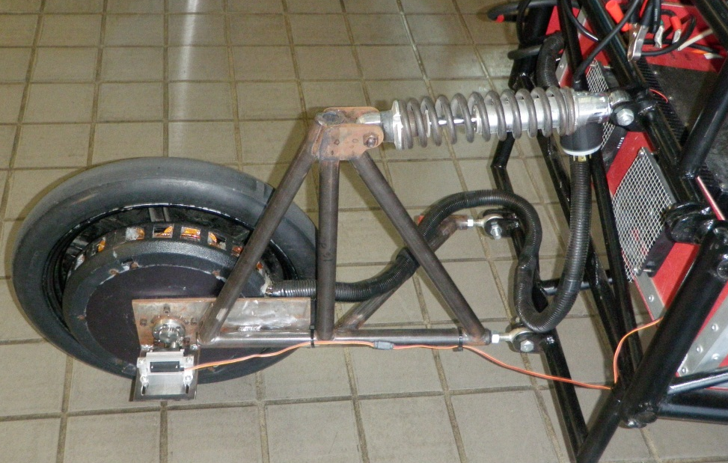
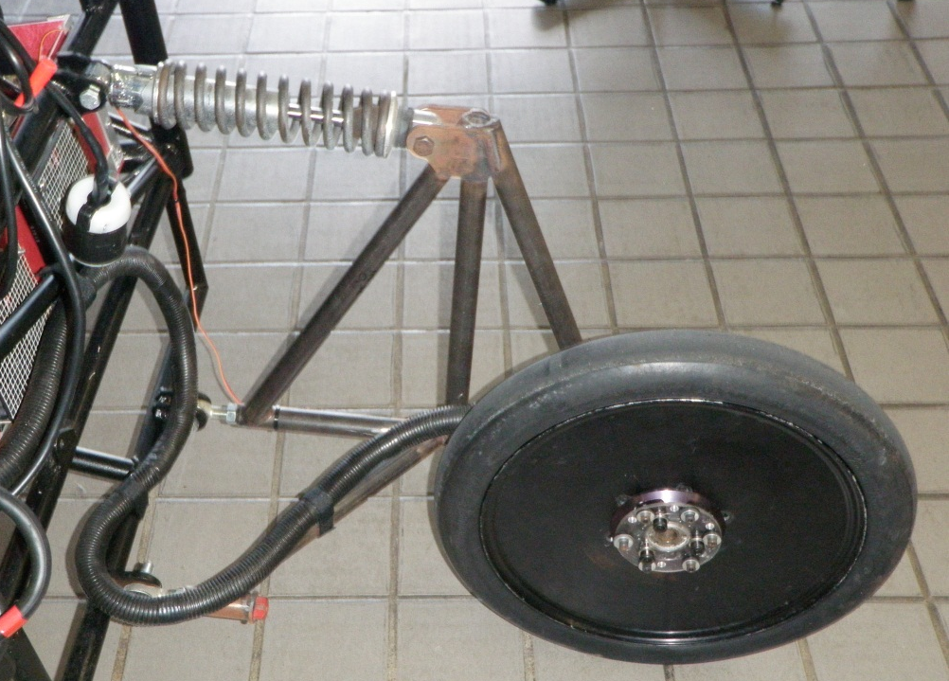
Functional Requirements – ME
Reduce stress on drive motor
Back left
Back right

Slide 11
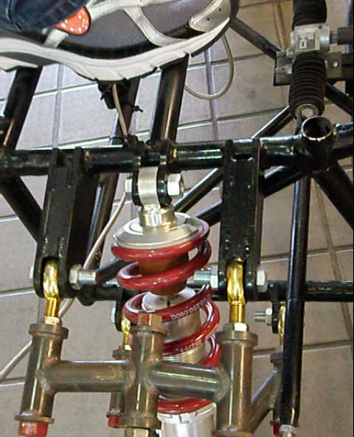
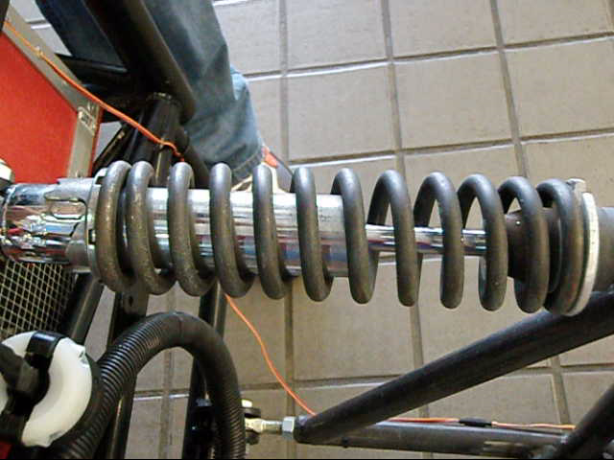
Functional Requirements – ME
Improve front (below) and rear (below right) suspensions

Slide 12
Non-Functional Requirements – ME
Driver cockpit equipped with outside air circulation
Roll cage must be padded with energy-absorbing material
Ensure steering column meets safety requirements

Slide 13
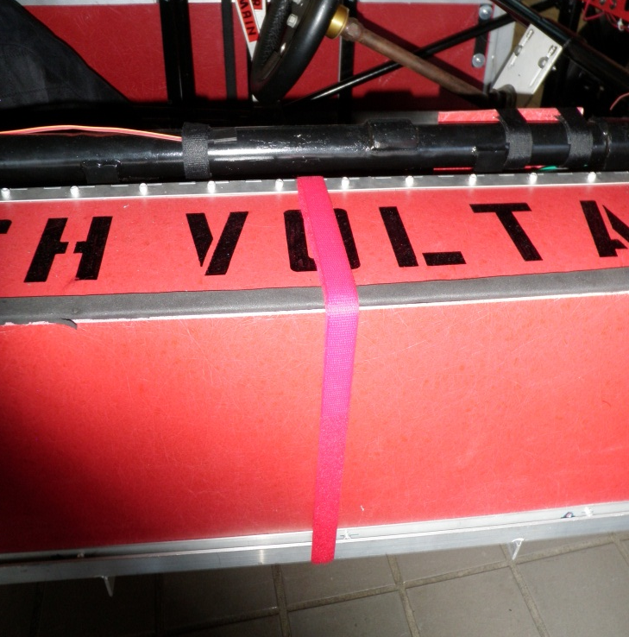
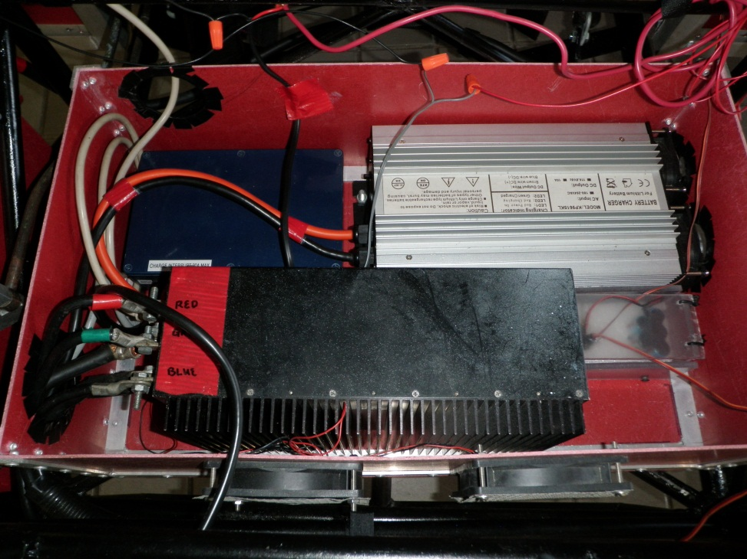
Non-Functional Requirements – ME
Improve method of securing batteries to car
Improve electronics housing enclosure

Slide 14
Functional Requirements – EE
Selection of solar cells
Design solar array integration
Design a driver interface that allows drive system engagement from the cockpit.
Design charging system to interface the solar arrays with the batteries
Allow charging of batteries while in motion

Slide 15
Non-Functional Requirement – EE
Implement a warning light/safety system showing when power is engaged.
Add road safety functions (lights, horn)

Slide 16
Constraints
Mechanical

Slide 17
Mechanical Constraints
Dimensions for car
  Length 5.0 m
  Width 1.8 m
  Height 1.6 m
Weight Requirement
  No total minimum
  80 kg Driver
  Ballast for supplement

Slide 18
Mechanical Constraints
Body Constraints
  Hard tow point
  Minimum three (3) tires
  Maximum of two body parts when stationary
  Moving parts must be covered
Cockpit
  Main goal
  Seat position
    27 degrees minimum
    No more than 15cm from center
  5 point seat belt
  Roll cage
    5 cm from driver helmet
    Foam
    Encompass entire driver

Slide 19
Mechanical Constraints
Visibility
  70cm eye level
  100 degrees from center
  Windshield shatter resistant
  Rear viewing system
Braking
  Balanced
  Dual system
  Parking brake
  Performance test

Slide 20
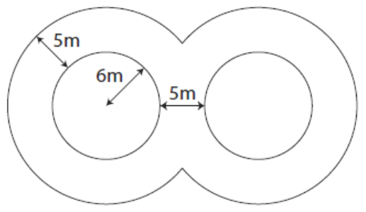
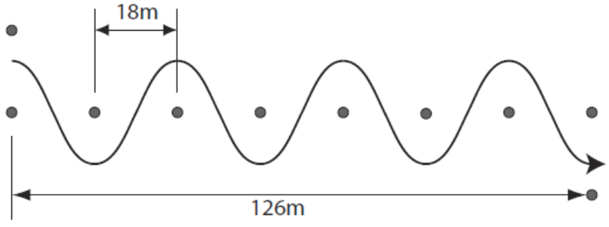
Stability
Figure 8 Test
Slalom Test

Slide 21
Constraints
Electrical

Slide 22
Electrical Constraints
Natural solar radiation received directly by the solar array is the only source of energy that can be used for propulsion.
Vehicle operation must be under the sole control of the driver.

Slide 23
Electrical Constraints
Solar Arrays cannot exceed a maximum of 6.00 m².
Maximum of 6 different types of panels can be used.
Cells must be from approved list or approved by ASC.

Slide 24
Electrical Constraints
LiFePO4 Batteries are limited to a weight of 30kg.
All batteries must have protection circuitry appropriate for the battery technology used.
All battery modules, battery protection circuitry, and main fuses must be fully contained in enclosures that are electrically isolated from the car.

Slide 25
Electrical Constraints
Battery enclosures must be equipped with a forced ventilation system.
The car must be equipped with a single throw, manually operated, switch to quickly isolate the battery, motor, and array from each other and the electrical system of the vehicle.

Slide 26
Electrical Constraints
Must be equipped with an electrical cutoff switch that can be externally activated in emergency situations.
All electrical cables must be properly sized to expected system currents.
All lighting must be clearly visible from 30 m.

Slide 27
Test Plans
Mechanical

Slide 28
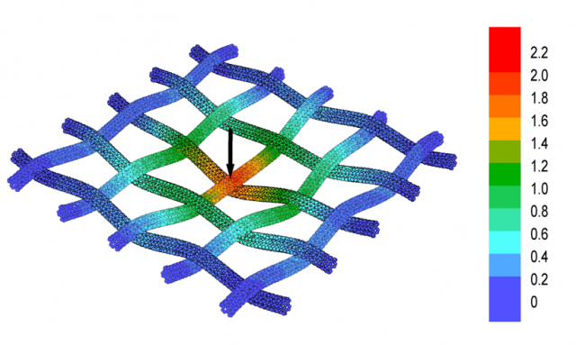
Test Plans
Finite Element Method (FEM)
  Used to test much of the mechanical requirements
Example of FEM on woven cloth (I Mechanica)

Slide 29
Test Plans
Driver Cockpit
  Ventilation Test
Seat
  Measurement/Positioning Test
Implemented hand brake
Redesigned brake system for automatic regeneration

Slide 30
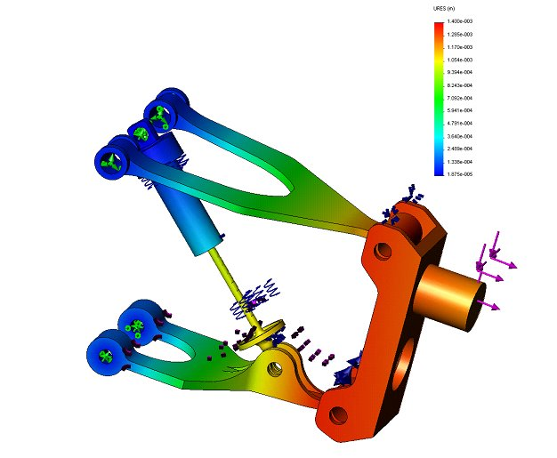
Test Plans
Suspension
  Rear suspension
    Reduce stress on drive motor
  Front Suspension
Roll cage
FEM analysis of vehicle suspension (Penmethsa)

Slide 31
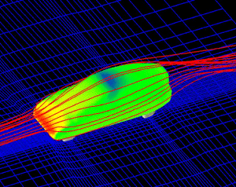
Test Plans - ME
Design composite body
  Shell over existing chassis
  Drag Area Test
Flow visualization using FEM

Slide 32
Test Plans
Electrical

Slide 33
Tests
Batteries for defects or unsafe operating voltage
Motor
Solar Arrays for output voltage potential
Power Charger (self-test)
Battery Protection System
Control Interface System
Ensure protection circuit and fuses are electrically isolated from the car

Slide 34
Tests
Main Power Switch and External Power Cut-Off Switch
Road safety lighting devices
Horn
Regenerative Braking System
Ensure electrical shock hazards are protected from inadvertent human contact
Test Drive!!!

Slide 35

Questions

Slide 36
Work Cited
American Solar Challenge. (2010, September 1). Regulations. Retrieved September 23, 2010, from American Solar Challenge: <http://americansolarchallenge.org/events/asc2010/wp-content/uploads/2010/09/ASC2012Regs-External-Revision-A.pdf>.
I Mechanica. FEM of woven cloth. Retrieved September 27, 2010 from <http://imechanica.org/node/786>.
Penmethsa, Harish. (2009, June 4). Frequency of Time Response Analysis on Shock Absorber. Retrieved September 27, 2010 from <http://penmethsa.blogspot.com/2009/06/time-and-frequency-responce-analysis-on.html>.

